Slide 1
How to program snake
David Rutsch & Morgan McCollum

Slide 2
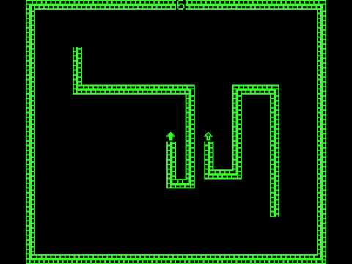
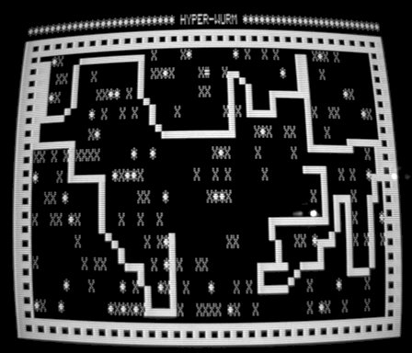
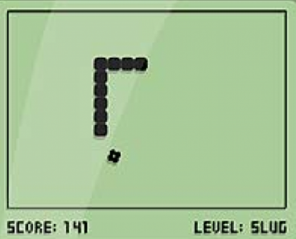
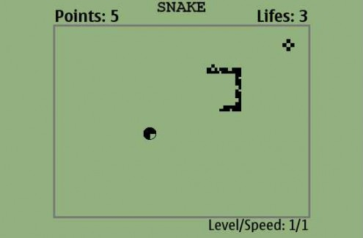
History
First released during the mid 1970s
Preloaded on Nokia phones in 1997
Snake II: introduced bonuses and mazes, removed lethality from walls
Snake: monochrome graphics and 4 directions
Concept from arcade game “Blockade” in 1976
First known computer version “Worm” in 1978

Slide 3
concept
The player controls a line made up of rectangles (resembling a snake) which moves around a grid picking up food and trying to avoid hitting its own tail.
Each time the snake eats a piece of food, its tail grows longer and speed increases, making the game more difficult.
The user controls the direction of the snake's head (up, down, left, or right) and the snake's body follows.
The player cannot stop the snake from moving while the game is in progress and cannot make the snake go in reverse.
http://www.sourcecodester.com/visual-basic-net/4800/snake.html

Slide 4
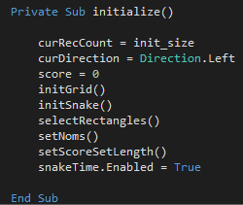
Setting up the game
First create the space for the game to take place (initGrid)
Then create the space for the snake body to inhibit and set the coordinates for where it should appear (initSnake)
Fill in the space with rectangles/snake body parts (selectRectangles)
Finally, the board is prepared with random pieces of food (setNoms)
Score is set to 0 and tracked throughout the duration of the game (setScoreSetLength)
Timer begins running

Slide 5
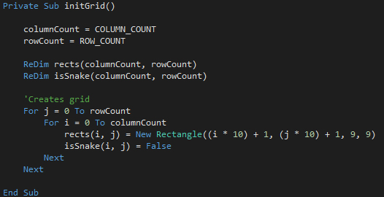
Creating the grid
Column and row count set the size of the game board

Slide 6

Creating the snake: Structures
Classes and structures are both container types, meaning they hold other types as members. A container type is useful for gathering a set of data items, such as customer information, that is closely related but cannot be held in a single elementary type. A class or structure can contain data members to hold these items and code members to manipulate them. The members can then be referred to individually, or the container can be treated as a single entity.
http://msdn.microsoft.com/en-us/library/aa289521(v=vs.71).aspx

Slide 7
Structures v. classes
A structure can be preferable when:
You have a small amount of data and simply want the equivalent of the UDT (user-defined type) of previous versions of Visual Basic
You perform a large number of operations on each instance and would incur performance degradation with heap management
You have no need to inherit the structure or to specialize functionality among its instances
You do not box and unbox the structure
You are passing blittable data across a managed/unmanaged boundary
A class is preferable when:
You need to use inheritance and polymorphism
You need to initialize one or more members at creation time
You need to supply an unparameterized constructor
You need unlimited event handling support
http://msdn.microsoft.com/en-us/library/aa289521(v=vs.71).aspx

Slide 8
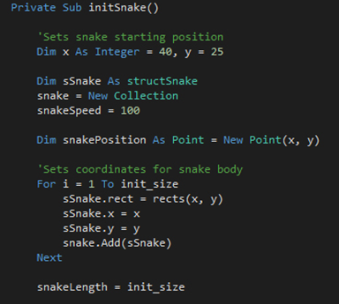
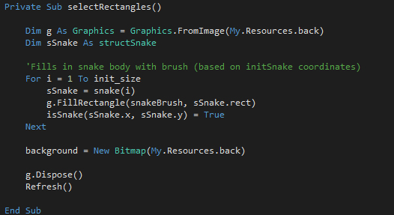

Creating the snake
Fills the body of the snake with colored rectangles
Sets up the body of the snake at the desired starting coordinate

Slide 9
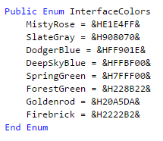
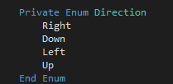
Moving the snake: ENUMS
If you have a set of unchanging values that are logically related to each other, you can define them together in an enumeration. This provides meaningful names for the enumeration and its members, which are easier to remember than their values. You can then use the enumeration members in many places in your code.
The benefits of using enumerations include the following:
Reduces errors caused by transposing or mistyping numbers.
Makes it easy to change values in the future.
Makes code easier to read, which means it is less likely that errors will be introduced.
Ensures forward compatibility. If you use enumerations, your code is less likely to fail if in the future someone changes the values corresponding to the member names.
http://msdn.microsoft.com/en-us/library/8h84wky1.aspx

Slide 10
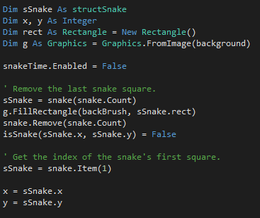
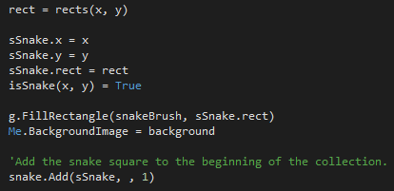
Moving the snake
Pauses the timer and begins to move the snake parts
The snake is moved by removing the last square and inserting a new one at the beginning

Slide 11
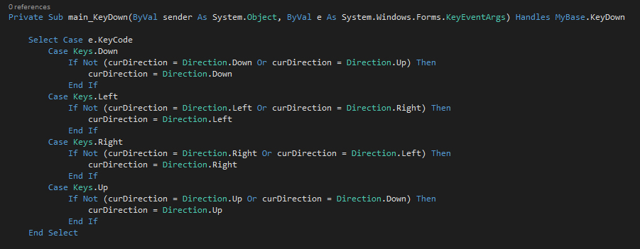
Direction – binding controls
Determines the direction of the snake based on key strokes

Slide 12
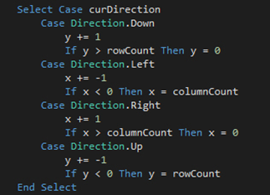
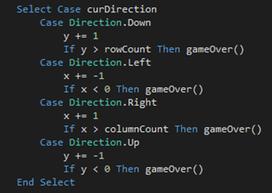
Direction — with or without borders
Borderless
Walls Enabled
Determines whether the game should end when the snake hits a wall

Slide 13

Timer
Generates recurring events in an application.
http://msdn.microsoft.com/en-us/library/system.timers.timer(v=vs.110).aspx
Calls moveSnake() on each timer tick, moving the snake along at a set interval

Slide 14
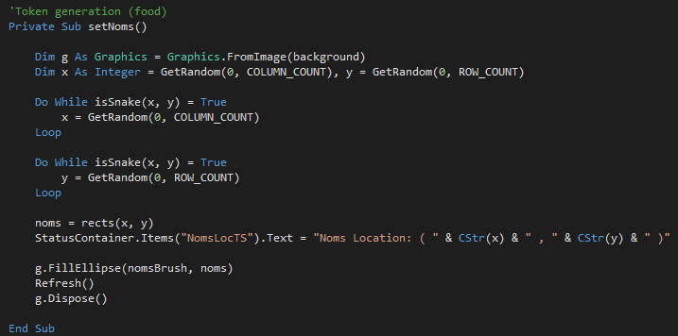
Food generation
Creates a random food point and calls a loop to make sure the space is not taken up by the snake already

Slide 15
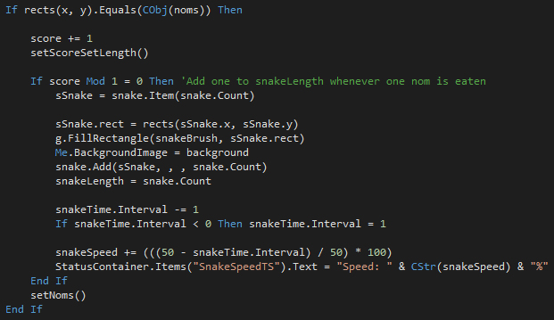
Snake eats food
When the snake hits a food piece, the score increases by 1, the snake gains a body part, and speed increases

Slide 16

Keeping track of Score: Status container and tool strips
A StatusStrip control displays information about an object being viewed on a Form, the object's components, or contextual information that relates to that object's operation from within the application.
The default StatusStrip has no panels.
Instead, the control consists of ToolStripStatusLabel which displays text, an icon, or both.
http://msdn.microsoft.com/en-us/library/system.windows.forms.statusstrip(v=vs.110).aspx

Slide 17

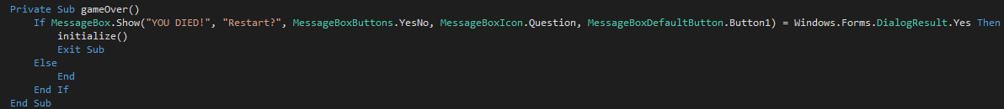
Game over
Game ends when the snake runs into itself
GameOver() method with message pop up and choice to restart

